Slide 1

Gis mini-course
Day 2: Spatial Data Manipulation and Topography

Slide 2
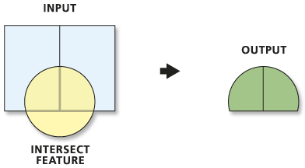
Spatial relationships: intersection
Return a combination of features that intersect
Retains data from both layers
Can be used to aggregate point data
Clips to just the intersection; can be used to spatially filter data

Slide 3
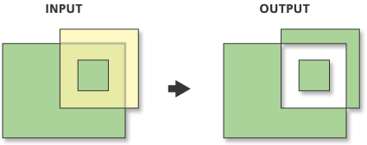
Spatial relationships: Difference
Return a combination of features that removes intersection

Slide 4
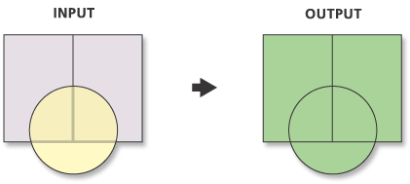
Spatial relationships: Union
Rectangle: 2 parts
Circle: 1 part
Union: 5 parts
Return a combination of features
New enclosures create new parts of the geometry
Can be very useful when translating data from one set of polygons to another (Ex: census tracts)

Slide 5
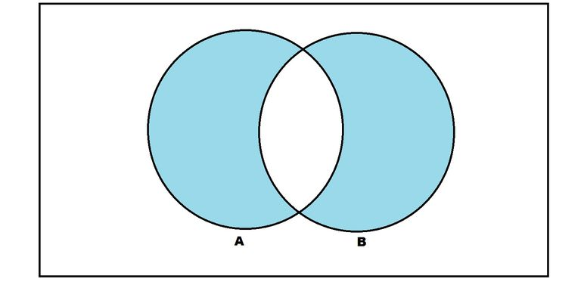
Spatial relationships: Symmetrical difference
Return a combination of features that is a union but excludes their intersection

Slide 6
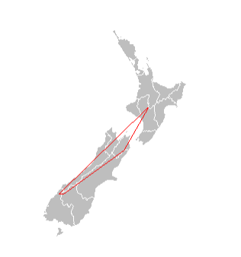
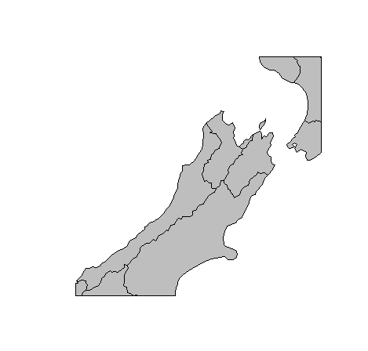
Cropping
Cropping is simply reducing a shapefile by using another as a reference
Can mix points, polygons, and lines
Uses the extent of another shapefile, not its exact outline

Slide 7
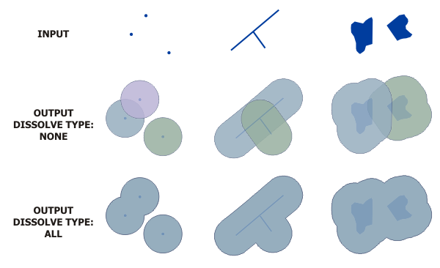
Buffering
Returns buffer polygons to specified distance (radius)

Slide 8
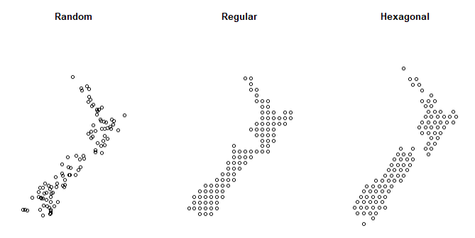
Regular/Random points
Return a regular grid of points or random points
Useful for sampling or setting up polygon grids

Slide 9
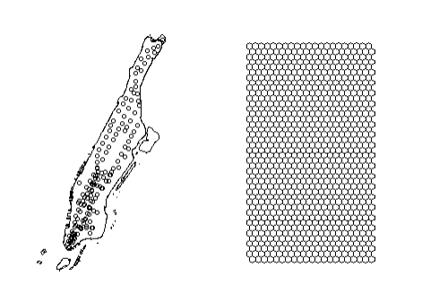
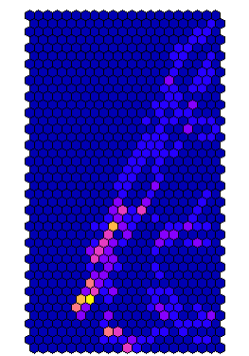
Hexagonal binning/ hexbins
Rather than circular buffers or regular square grids, hexbins can be useful to aggregate point data
Better than squares because the area is closer to a circle but with definite edges wither other hexagons

Slide 10
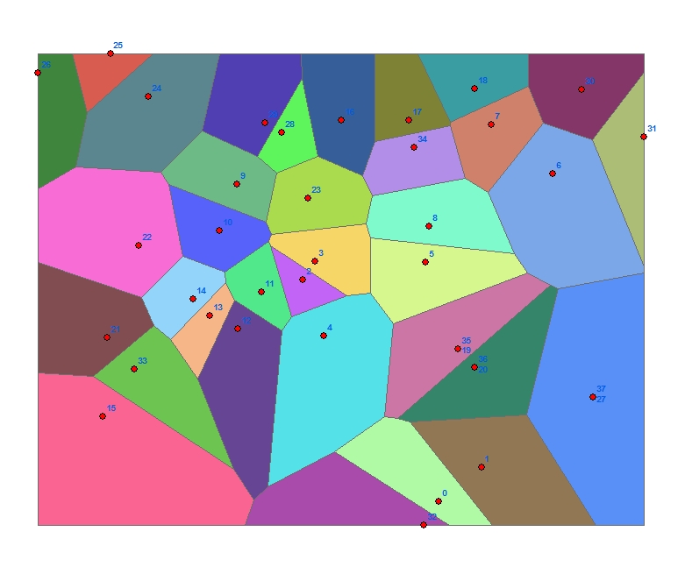
Polygon generation: Thiessen polygons
Rather than regular bins, Thiessen Polygons or Voronoi Polygons create cells that contain the area closest to each point in a shapefile
Useful for determining an “area of influence”

Slide 11
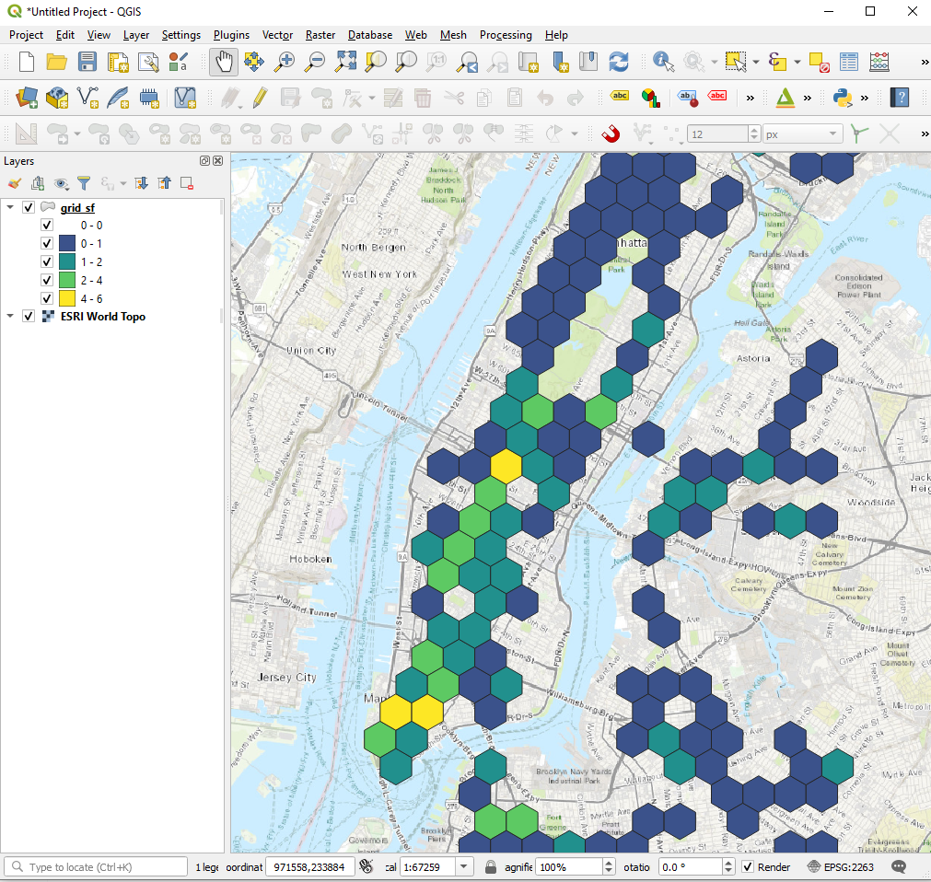
Saving shapefiles
You can save and load shapefile in R which means that you can pass data between R and GIS software like ArcGIS and QGIS!

